Slide 1
History of Desktop Computers
By Sahbaj Singh, Sukhpreet Sekhon

Slide 2
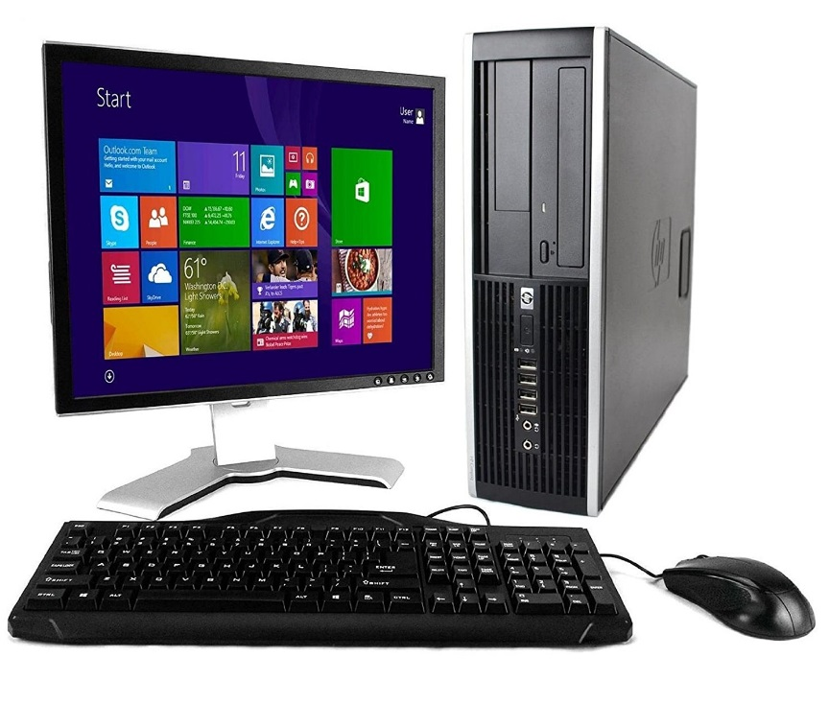
What is a Desktop Computer
First of all, the definition of a desktop computer also known as a personal computer is a computer that fits under or on top of a desk. These computers usually consist of a monitor, keyboard, mouse. Unlike a laptop, which is portable, a desktop computer is meant to stay at one location, and are way larger than laptops.

Slide 3
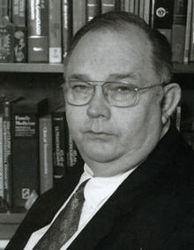
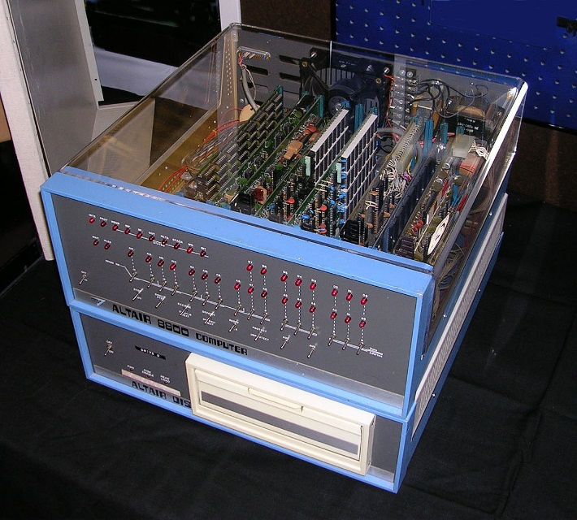
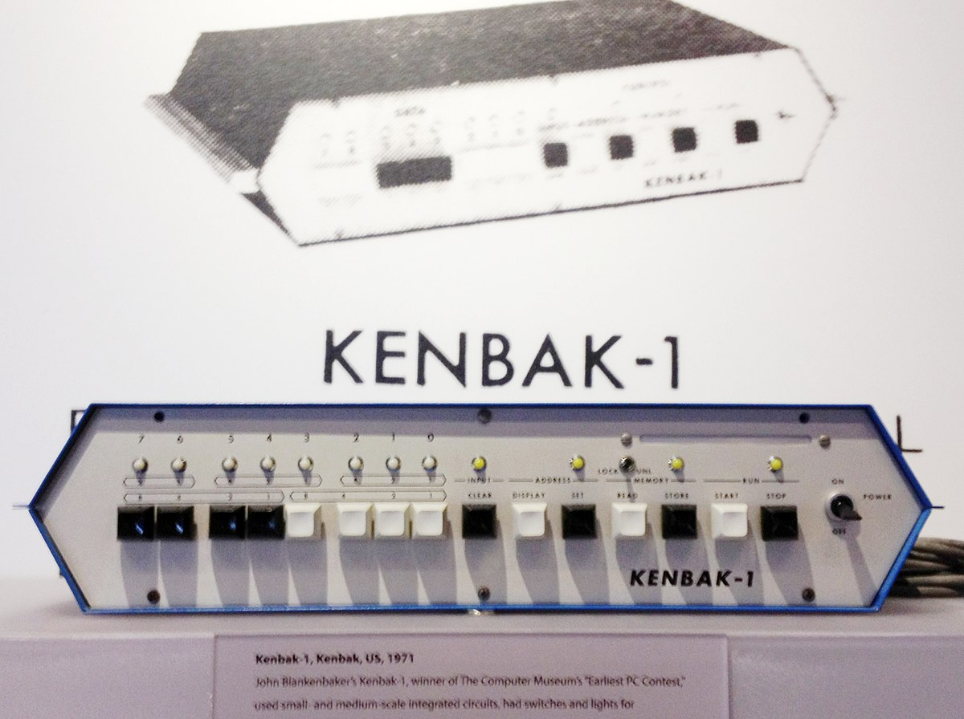
The Inventer
The first desktop computer also known as personal computer was created In 1975, Ed Roberts coined the term "personal computer" when he introduced the Altair 8800. Although the first personal computer is considered by many to be the KENBAK-1 which was invented by John V. Blankenbaker which was first introduced for $750 in 1971

Slide 4
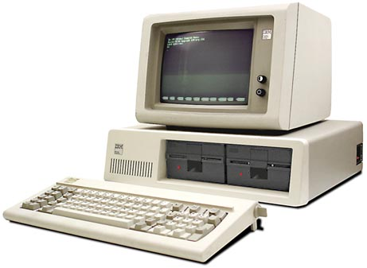
IBM PC
In 1981, Philip Don Estridge is known as the"father of the IBM PC“ and is known for developing the original IBM Personal Computer (PC)
He created the IBM Model 5150 from 1981
This computer sales growth were increasing rapidly.
The cost of this computer was 1,565 ~ $3,000 US dollars. It was expensive back in the days but everyone that could afford it had to buy it. It was the future of technology.

Slide 5
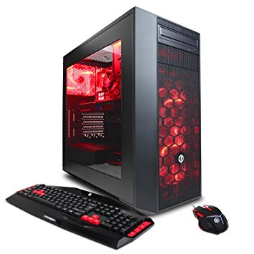
Best desktops in 2017/2018
Apple iMac MK452LL/A 21.5-Inch Retina 4K Display Desktop
CYBERPOWERPC Gamer Xtreme
NEW ALIENWARE AURORA

Slide 6
Whats inside a computer
Some of the main keys elements inside a desktop computers are…
Motherboard
CPU/processor
RAM (random access memory)
Hard drive
Power supply unit

